Slide 1

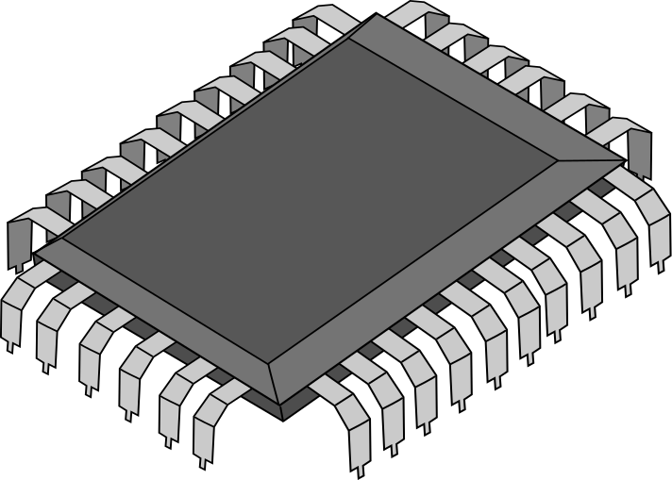
ACCELERATION OF 2D-CONVOLUTION
ON A RISC-V CORE

Slide 2
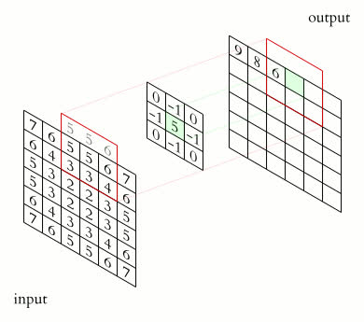
INTRODUCTION
.......
2D CONVOLUTION:
2D convolution is a linear transformation that involves a kernel sliding over a 2D input data to produce a single output pixel. It's a common type of convolution used in digital image processing.
ACCELERATION:
Parallelism
Custom Extensions
Caching and Memory Access

Slide 3
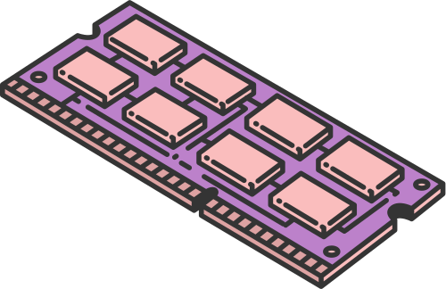

PROBLEM STATEMENT
Optimizing the performance of 2D convolution operations is critical for enhancing the efficiency of image processing, computer vision, and deep learning applications, particularly on systems with limited computational resources.
Challenges:
Computational Efficiency: 2D convolution is resource-intensive, requiring significant processing power and time.
Limited Resources: Systems with constrained computational resources (e.g., RISC-V cores) face challenges in maintaining both speed and accuracy.
Convolution Acceleration: The goal is to accelerate 2D convolution operations without impacting the core CPU’s performance or consuming excessive hardware resources.
Key Problem:
Hardware Block Design: A separate hardware block for convolution needs to be implemented to improve performance.
Design Constraints:
Cycle Efficiency: Reduce the number of cycles required for convolution.
Register Usage: Minimize the use of registers in the design.
Logic Elements: Limit the consumption of logic resources to achieve a balance between performance and resource utilization.

Slide 4

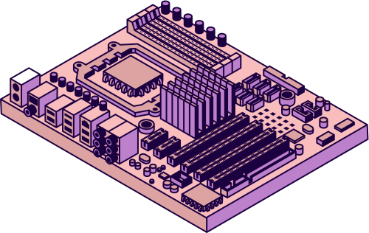
PROPOSED
SOLUTION
Our solution proposes a specialised hardware block dedicated to handling convolution operations.
PicoRV32 RISC-V core will be adopted as the processor and pre-existing extensions like Vector extension, Multiplication & Division will be utilized.
Fast Fourier transform convolution (FFT), which has an time complexity of O(NlogN) as opposed to conventional algorithm having a complexity of O(N2).
This project operates on kernel sizes 3x3,5x5,7x7.
The Aim is to achieve fewer multiplications performed, cycles saved, while not affecting the normal operation of the ALU and ensuring gain in performance, while maintaining the same power consumption.
Page 04

Slide 5
PROJECT STEPS
RISC-CORE
1.Defining Requirements
Clock:
0.5 GHz
Cache:
8 MB
2.Implementing FFT Convolution
Cores:
2
3.Parallelism
4.Vector Extension Implementation
5.Memory Management and Storage
CONVOLUTION
ENGINE
6.Simulation and Result Comparison

Slide 6
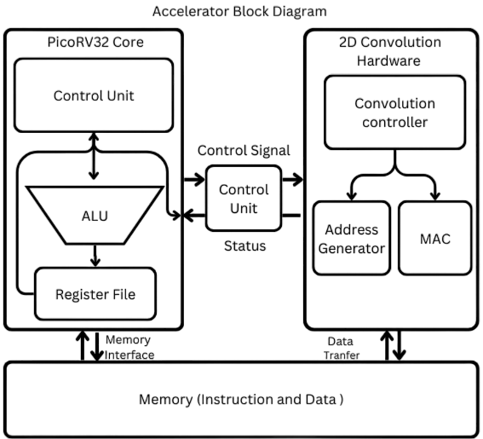
BLOCK DIAGRAM

Slide 7
THANK YOU
Ojas Kudari | 1BM22EC154
Rohith Vishnu Achari | 1BM22EC201
Sateesh Y Abbigeri | 1BM22EC223
Supraja S | 1BM22EC207

